Slide 1
TEAM NASHVILLE
Richard Desatnik, Katherene Qi, Divyangum Dutta, Boda Huo

Slide 2
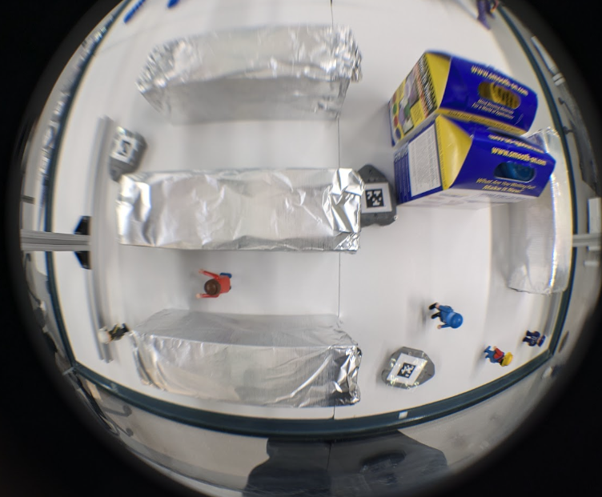
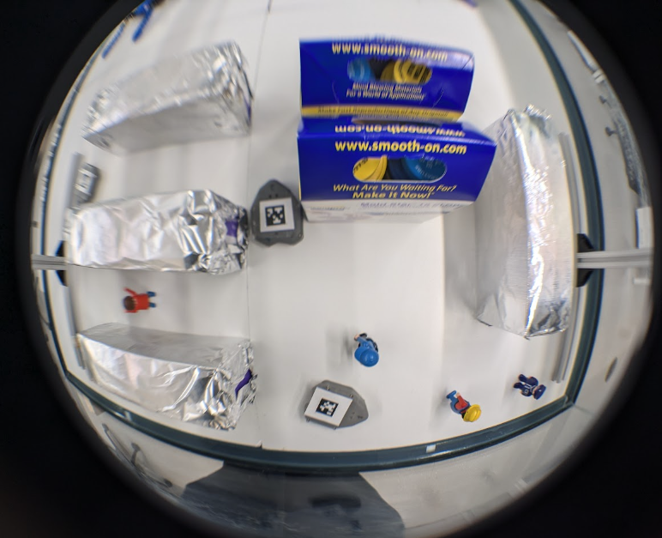
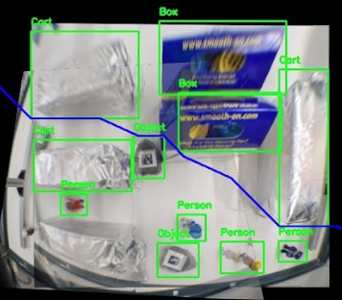
Intro
Research goal
Hardware Setup
Restoring the fisheye images
Image Stitching with SIFT
Learning and Recognition with YOLO
Path Planning
Summary and Conclusion

Slide 3
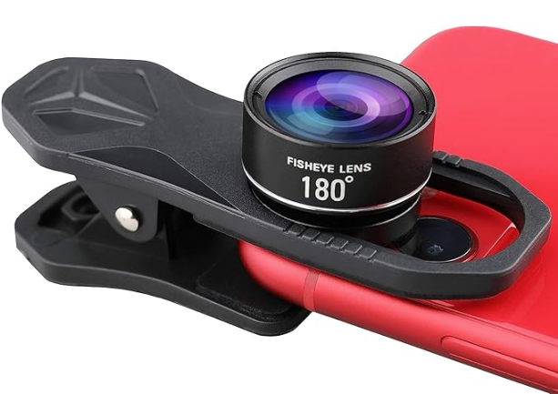
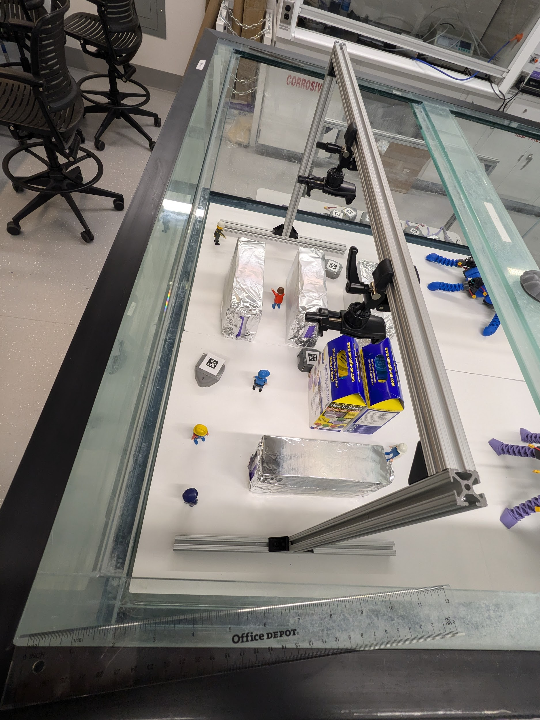
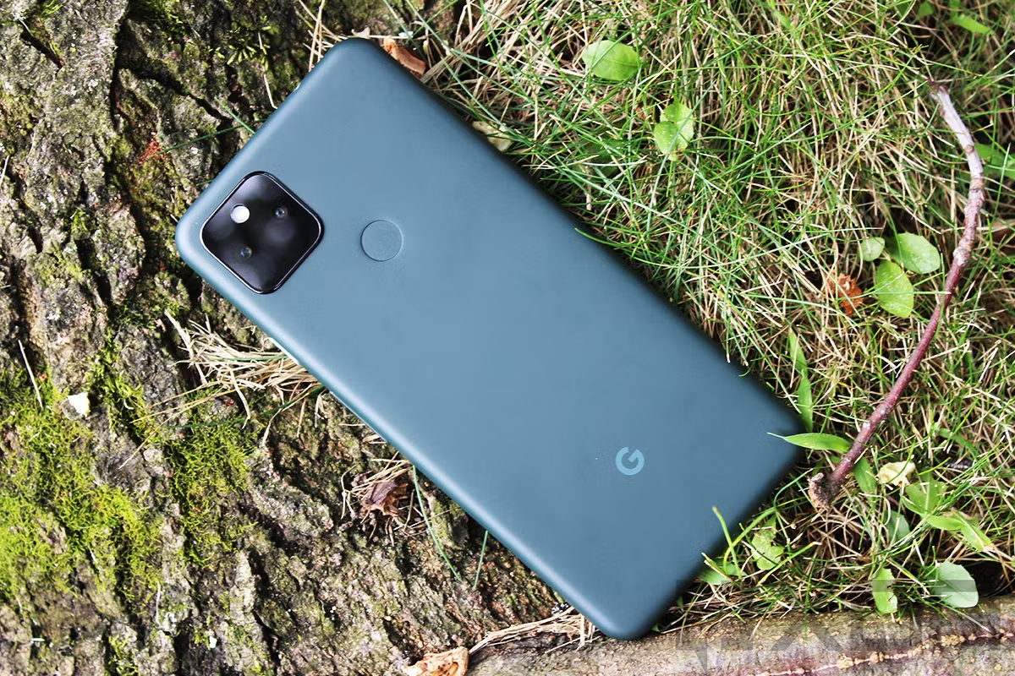
Hardware
3 Robots
6 People
4 Shelves
1 Additional Obstacle
Warehouse size
Height: 10.5m
Width: 16m
Length: 24.7m

Slide 4
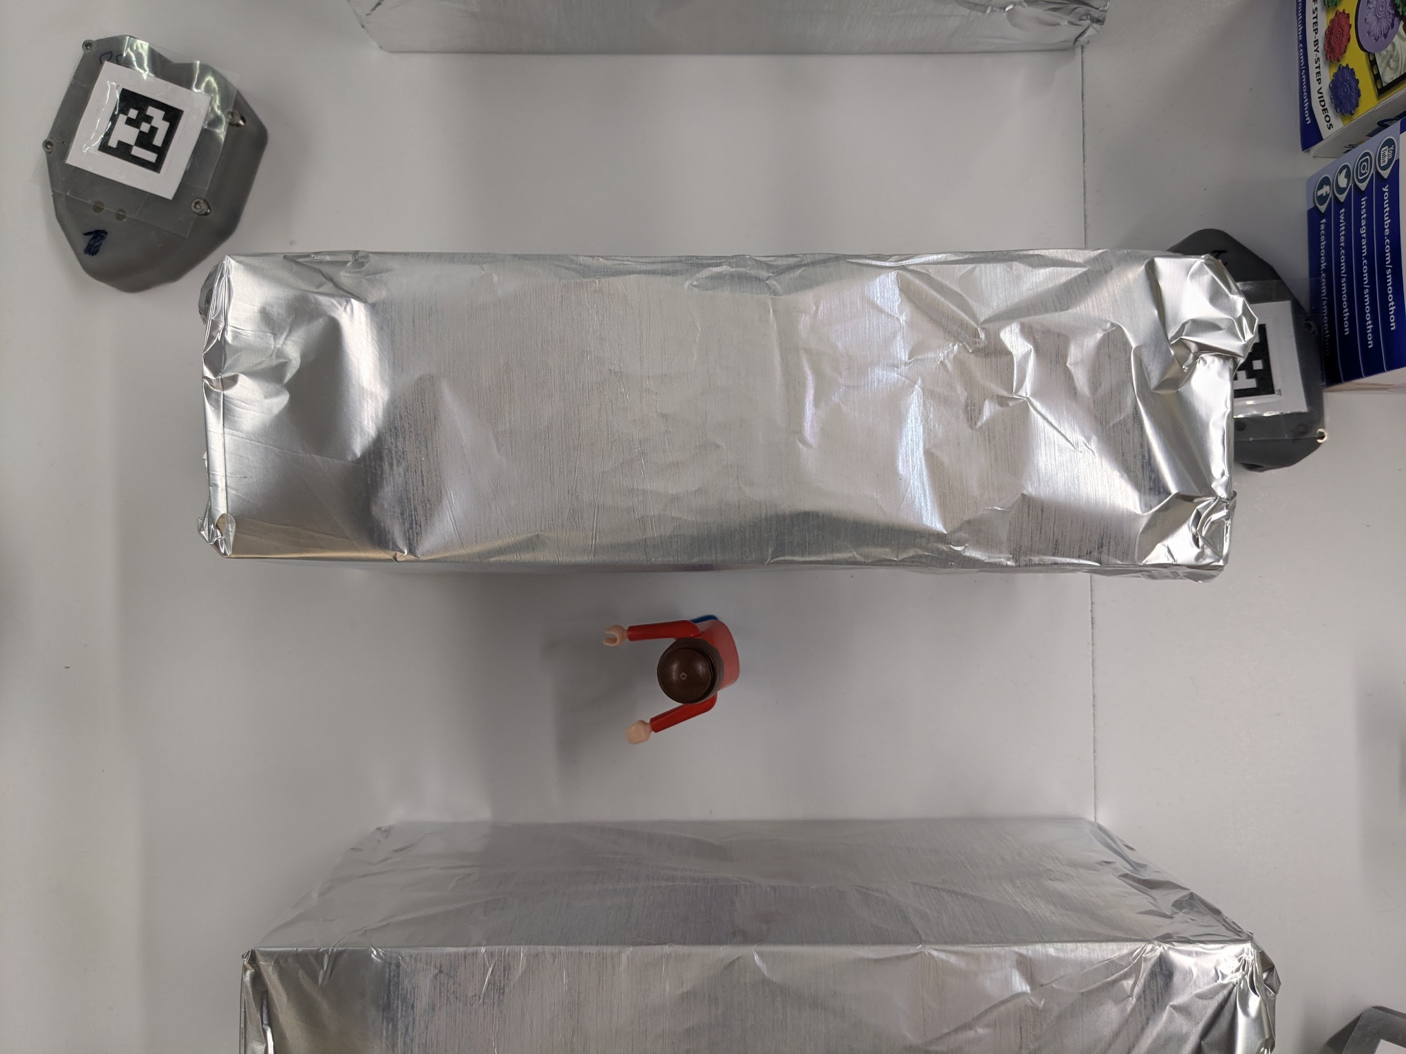
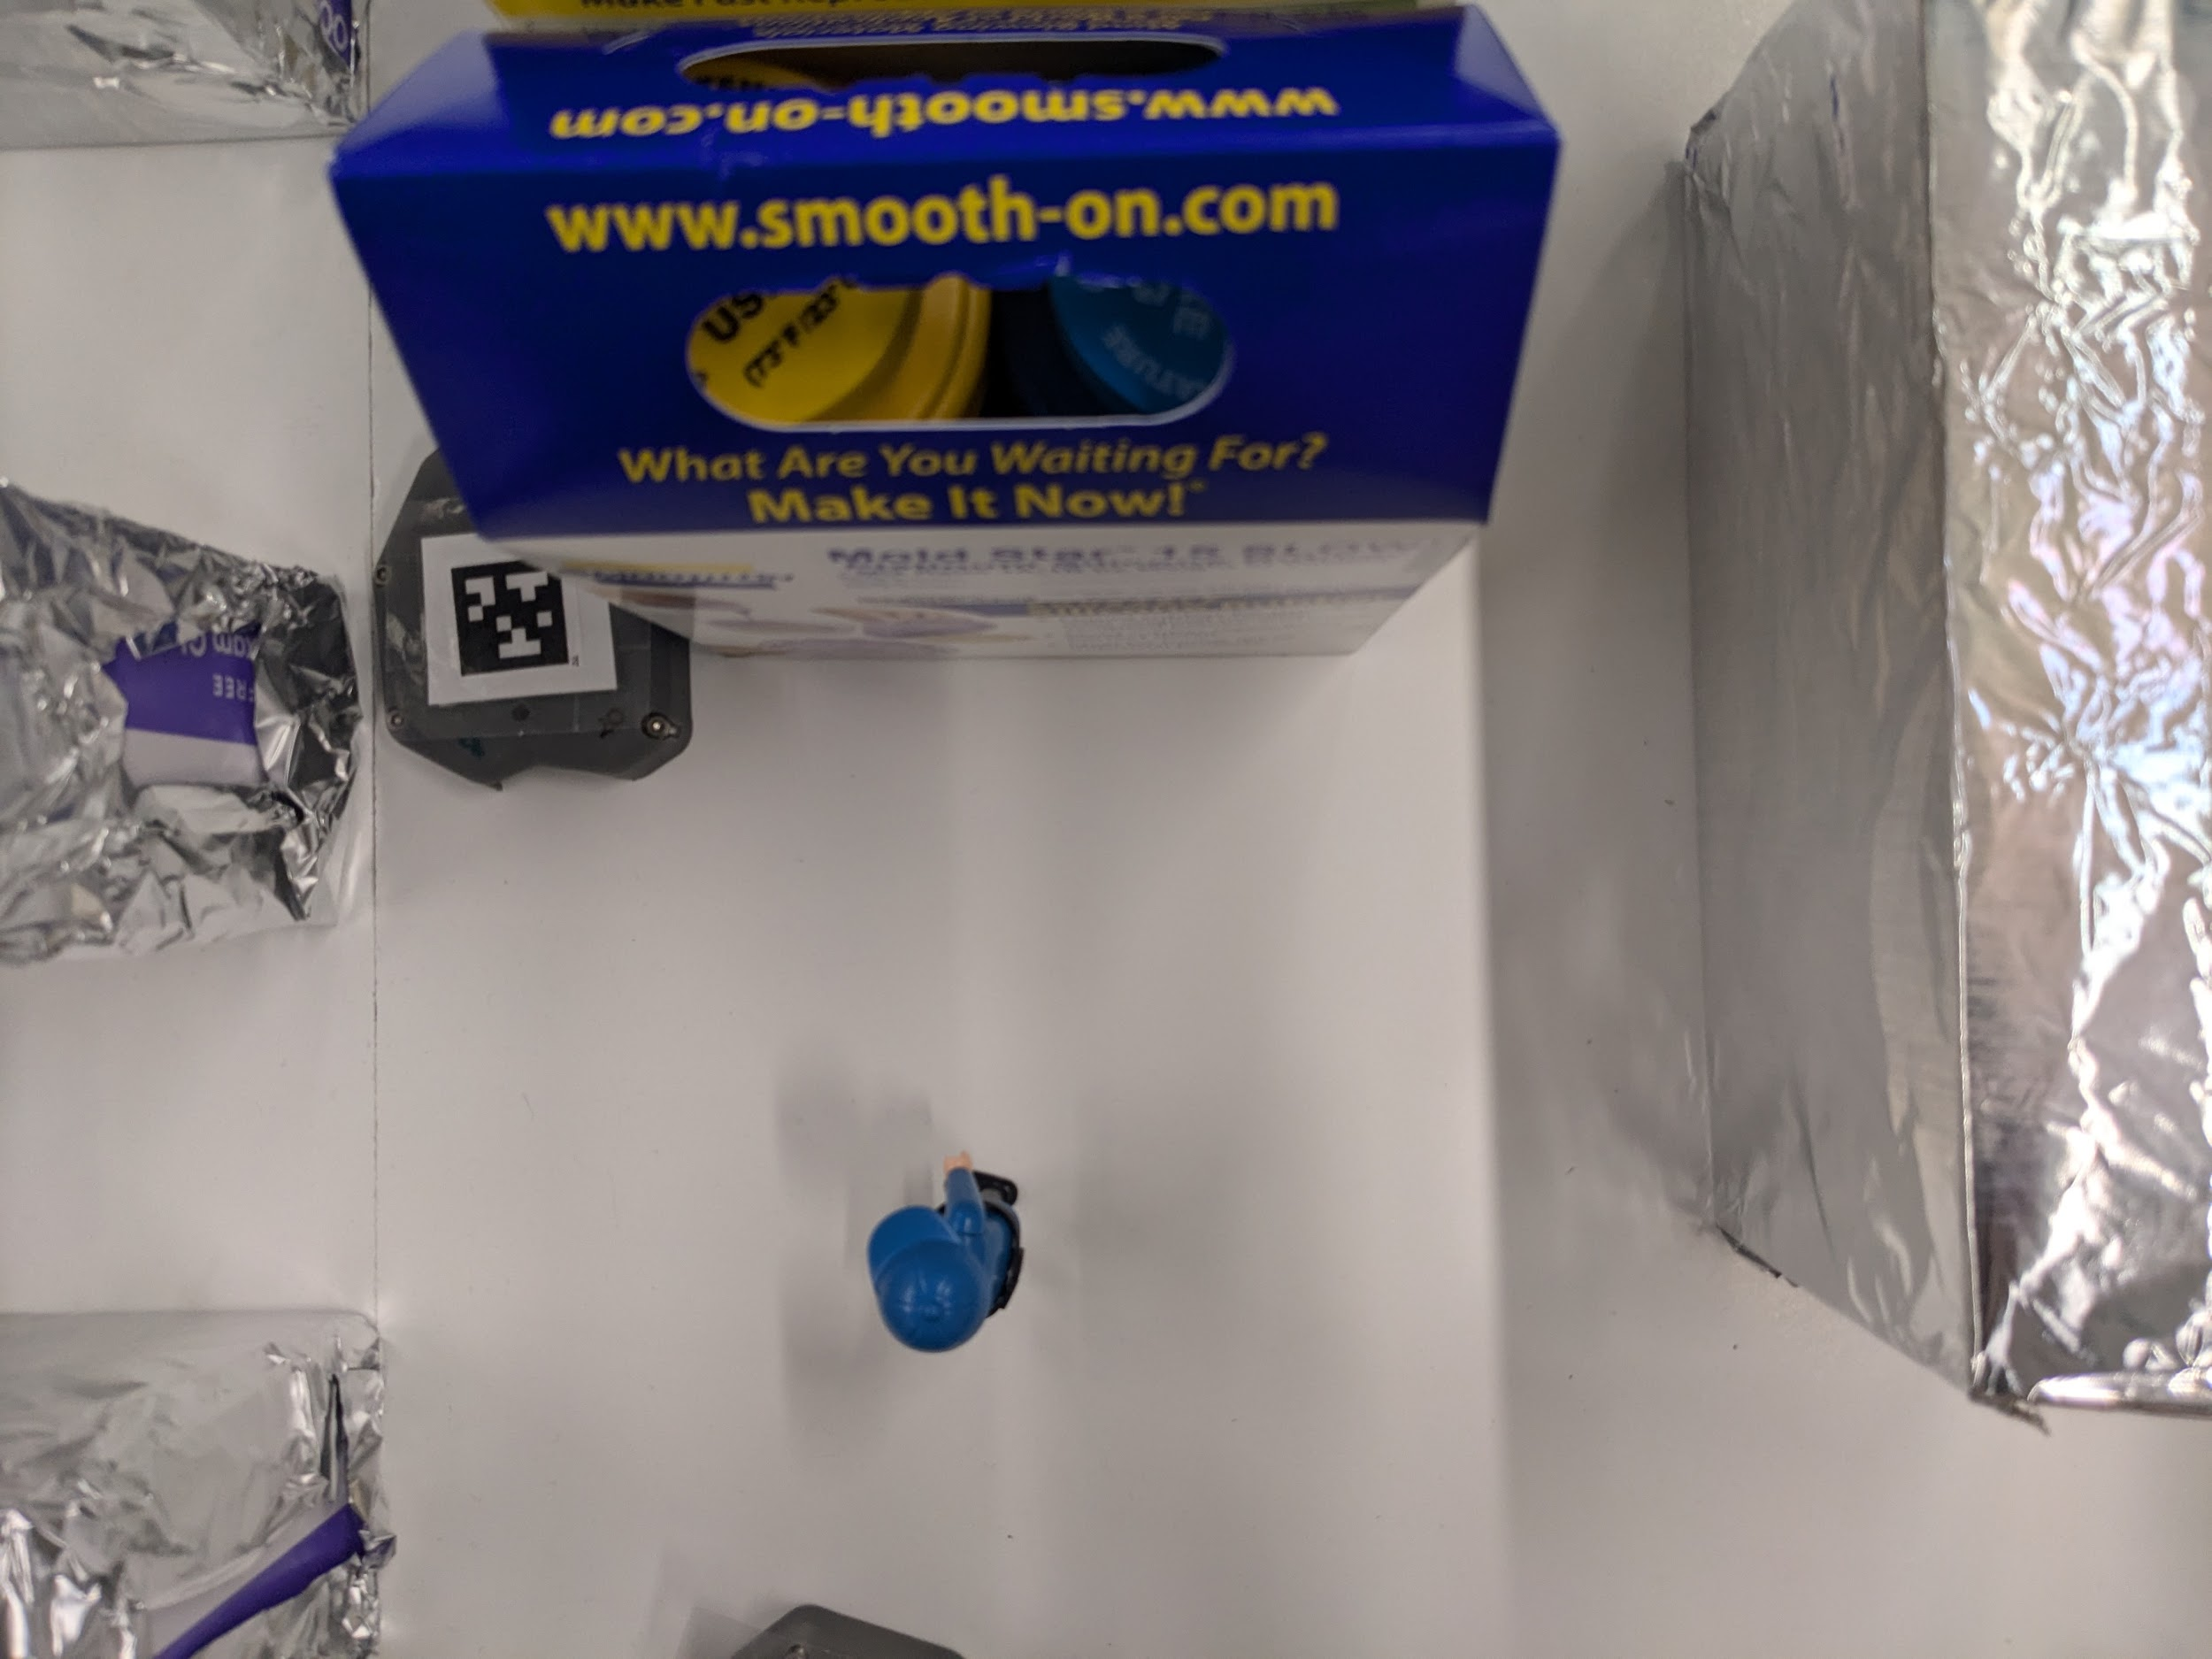
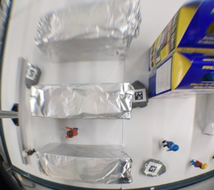
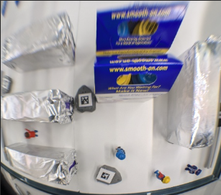
Fisheye Photos
Original image misses critical information
Fisheye covers area but is distorted
Image restoration with OpenCV
cv2.fisheye.estimateNewCameraMatrixForUndistortRectify
cv2.fisheye.undistortImage

Slide 5
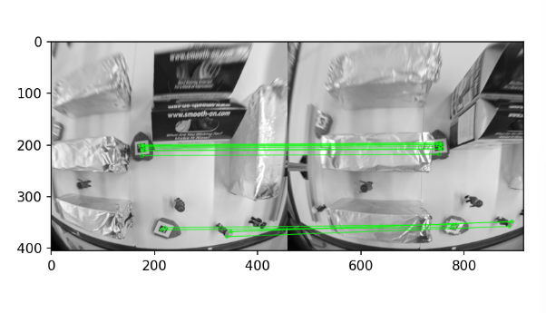
Matching Results
FlannBasedMatcher
Heuristic for good matches
Lowe’s ratio test
cv2.findHomography()
cv2.warpPerspective()

Slide 6
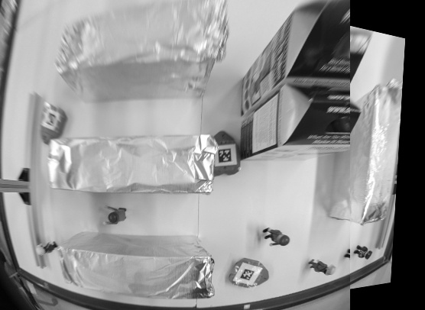
Notes:
I think I’ll rerun the code for this to remove the white lines going across the image.

Slide 7
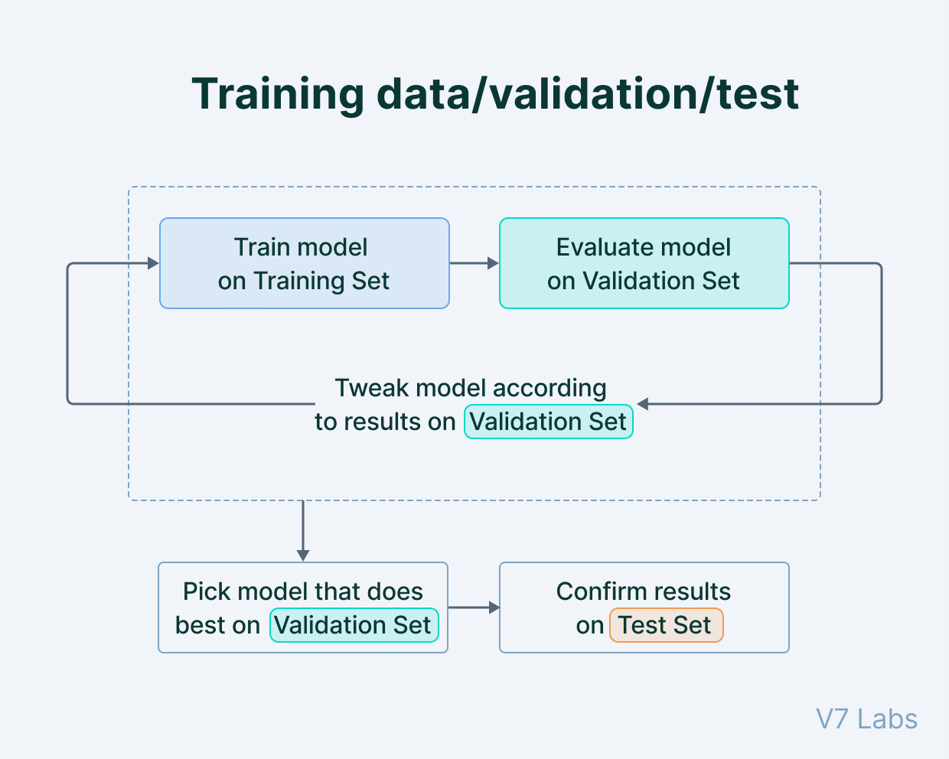
Using YOLO
Annotated images using labeling in YOLO format.
Classify objects into Shelf, Person, Robot etc.
50 epochs with a batch size of 16.
Can save past training data + add more data / learning.
Class labels and Bounding boxes with coordinates

Slide 8
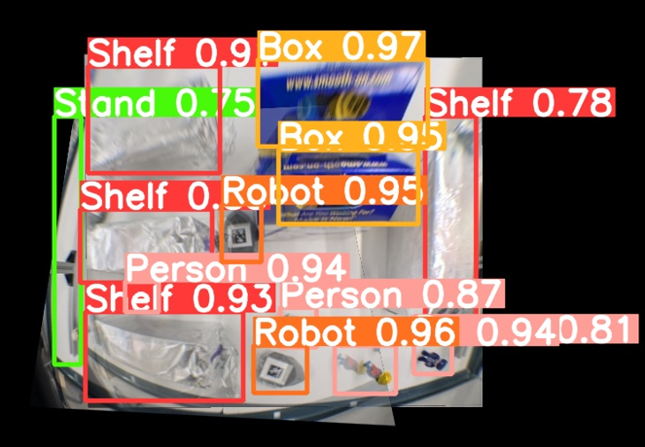
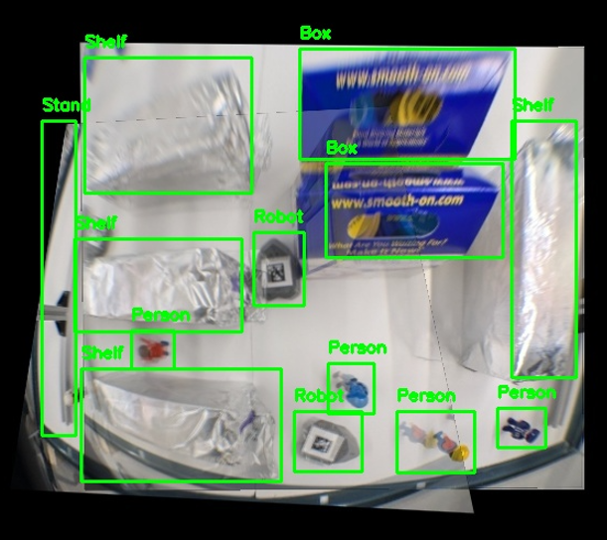
Results and Confidence Scores

Slide 9
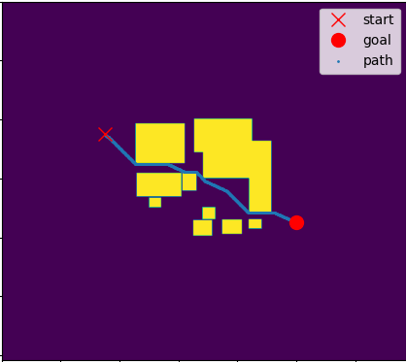
Path Planning
Objective
Enable robots to navigate around obstacles using path planning.
Visualize the path overlay on the environment for verification.
Path Planning Technique
Uses a shortest-path search algorithm on a binary cost-map.
Avoids obstacles (high-cost areas) and finds the most efficient collision-free route.
Optimized for real-time performance.

Slide 10
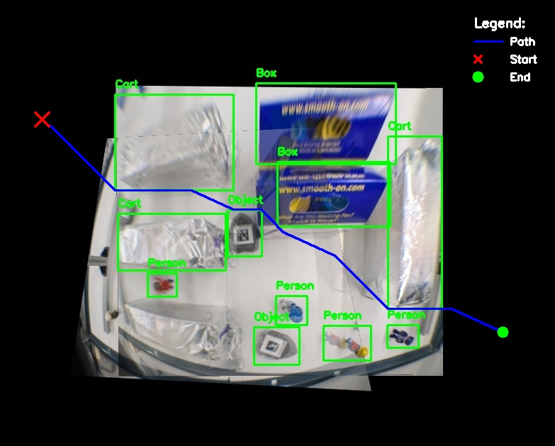

Path Results

Slide 11
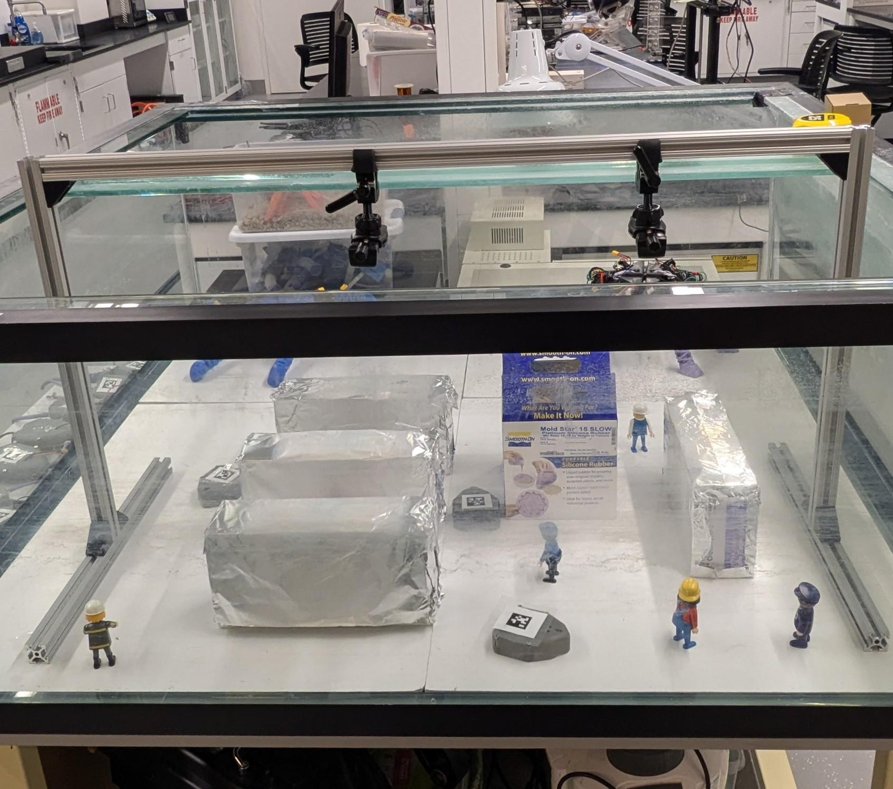
Next steps (future work)
Connect Robots + control them to move according to the path
Live stitching → using video feeds
Scaling to a bigger warehouse
Integrating more cameras and mirrors

Slide 12

Q & A

